Slide 1
EFR32BG22 Wireless Gecko SoC
ADC EXAMPLE

Slide 2
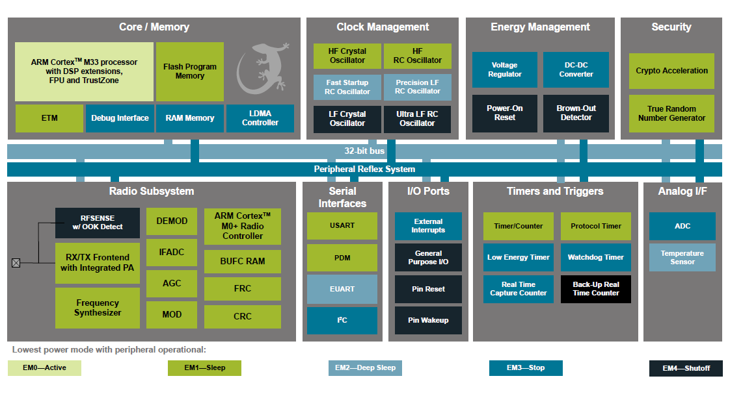
EFR32BG22 Wireless Gecko SoC Family ADC on the Chip -

Slide 3
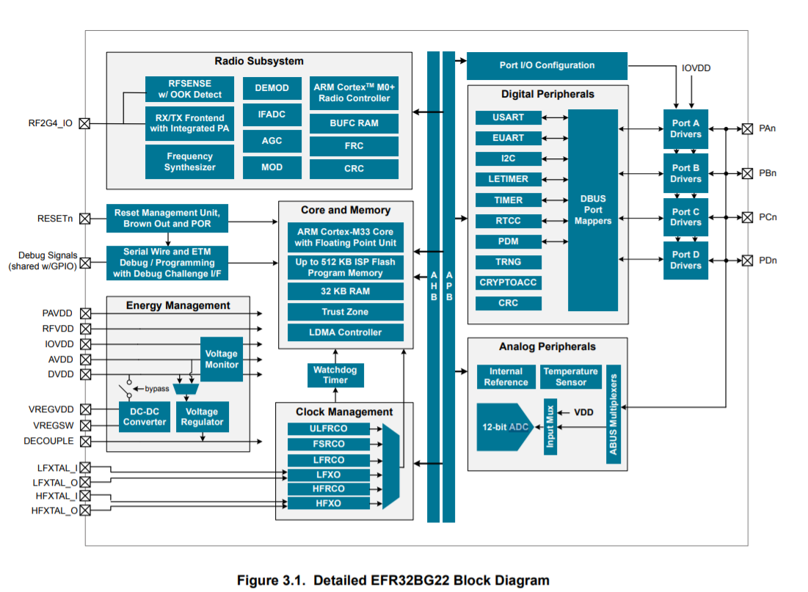


Specified at 1 Msps, ADCCLK = 10 MHz, OSR=2, unless otherwise indicated

Slide 4































code
static volatile double scanResult[NUM_INPUTS]; // for collectng inputs in a table
Take variable init of type IADC_Init_t (line no. 42) Look into #include "em_iadc.h"

